Slide 1
MILD-Master Stimuli
Timing and processing flow diagram

Slide 2
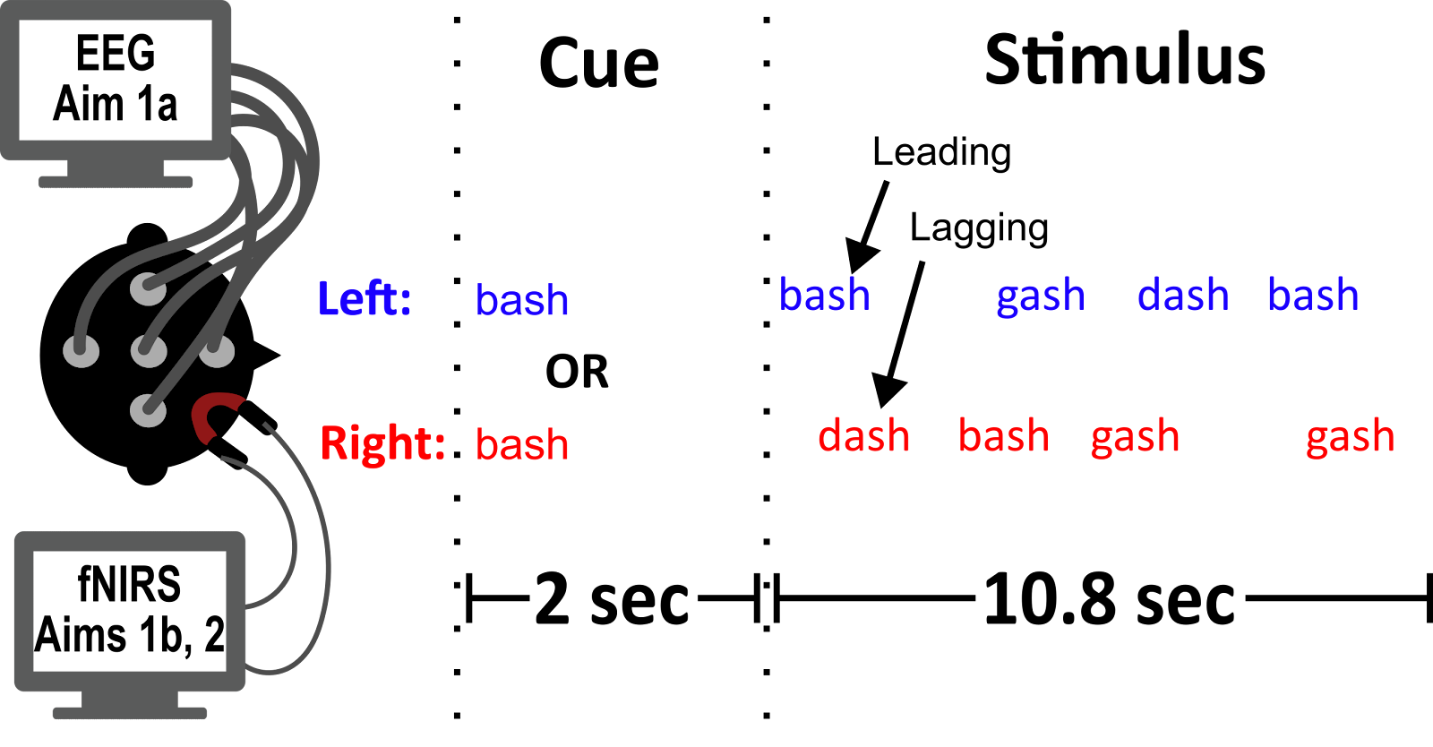
300 ms
?
50 ms
?
250 ms
9.6
?
8 token pairs * 800 ms/pair = 6.4 sec

Slide 3
Questions/To Dos
Target/Masker lead for the whole thing → First ERP dilemma
Only attenuation for ILD magnification?? Half and Half attenuation/amplification?
Number of trials
Alpha
NIRS
ERPs
Ensure ILDs only for ILD condition
Maximum number of bashs/Distance between Bashs (DOUBLE CHECK)
Currently: No bashs within 2 indices of each other (in either target or masker)
Bash cannot occur in masker when it occurs in target
Bash cannot occur on the first OR last token pair
Smoothing filter → I hear the intensity transitions in Magnified
Min/max number of bashs: 2-4
Write all word orders to a csv
Plot gain tracks for ild mag

Slide 4
Stimulus generation flow diagram (for each condition, for each trial….)
Create order of dashs and gashs for target and masker streams
Generate indices of bashs for both streams, with constraints. Replace existing dash or gash at selected indices in both streams
Loop through individual words and append sound waveforms to target/masker arrays, including delays
Spatialize target, masker and cue
- If ITD, delay contra ear
- If ILD, apply HRTF mag sp.
- If ILD Mag, apply full HRTF to calculate ITDs, then apply ILD magnifiication to HRTF mag. sp. Signal WITH ATTACK
Concatenate left channel data (cue, ISI data, target + masker) and same for right channel data
Write to file

Slide 5
Example Stimuli

Slide 6

What if we change the between word pair delay (all examples ITD500, within word delay = 250)
0 ms
50 ms
100 ms
250 ms

Slide 7
What if we change the within word pair delay (all examples ITD500, between word delay = 100 ms)
100 ms
250 ms
300 ms
400 ms

Slide 8
ILD Azimuth? (between delay = 100, within delay = 250)
Natural | Magnified
0 | 0
10 | 10
20 | 20
30 | 30
70 | 70

Slide 9
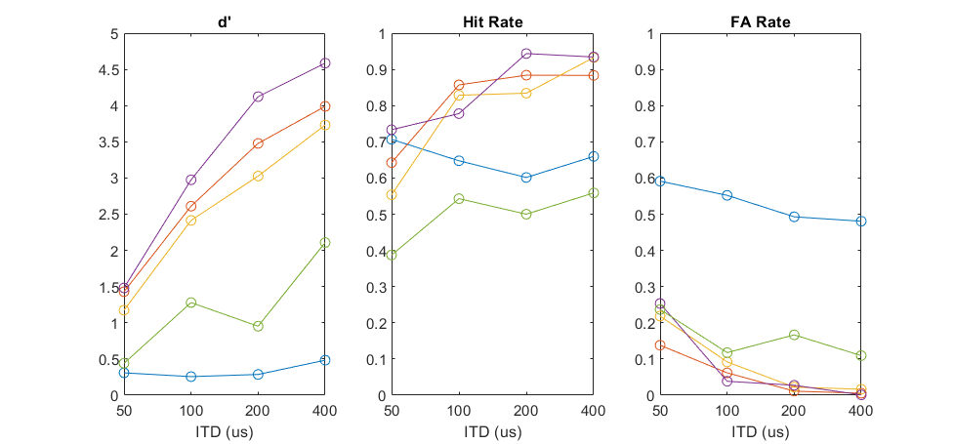
ITD Pilot
ITDs: 50,100,200,400 (60 trials each, 4 blocks of 60 trials), 12 token pairs

Slide 10
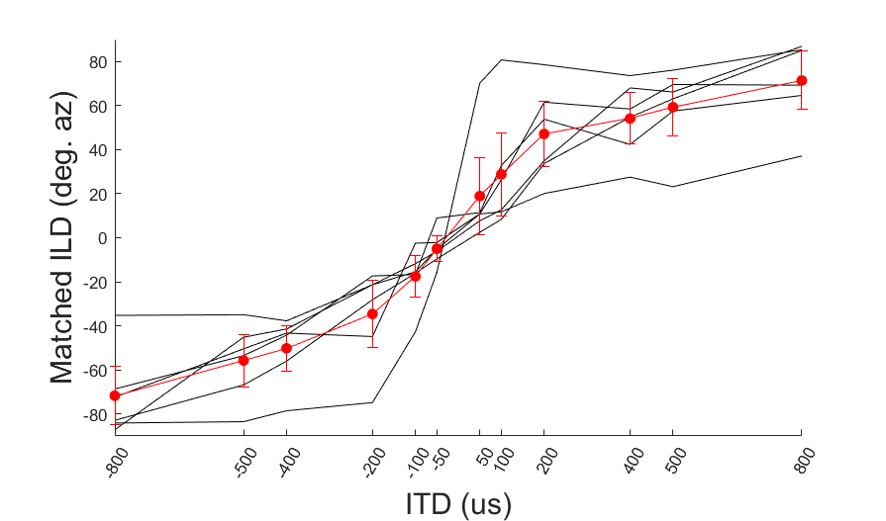
ILD to ITD matching (6 match trials per ITD, 5 subbies)

Slide 11
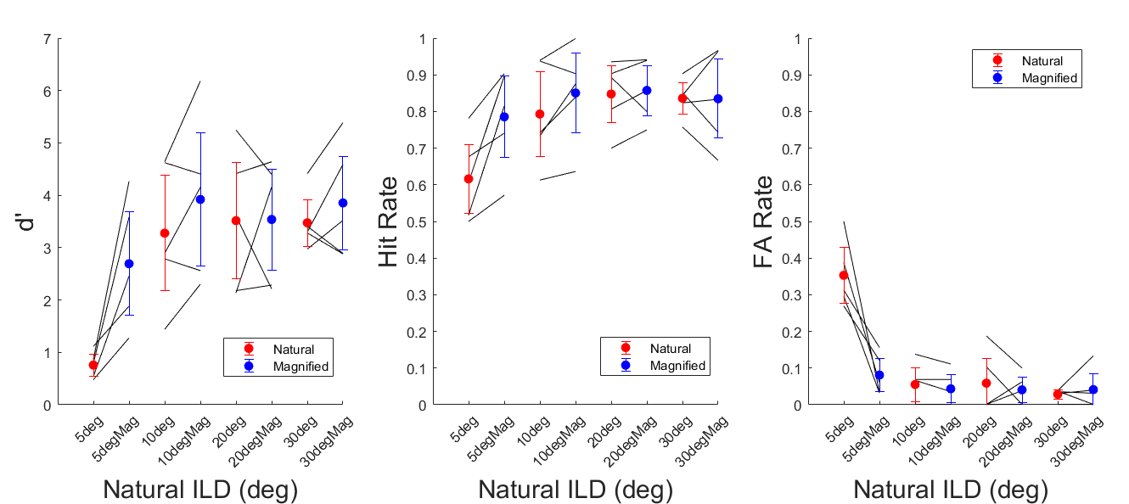
With 500 ms tokens, behavior seems to plateau beyond 5 deg. Natural ILDs (Maybe 10 if Ben stares at it!!)

Slide 12
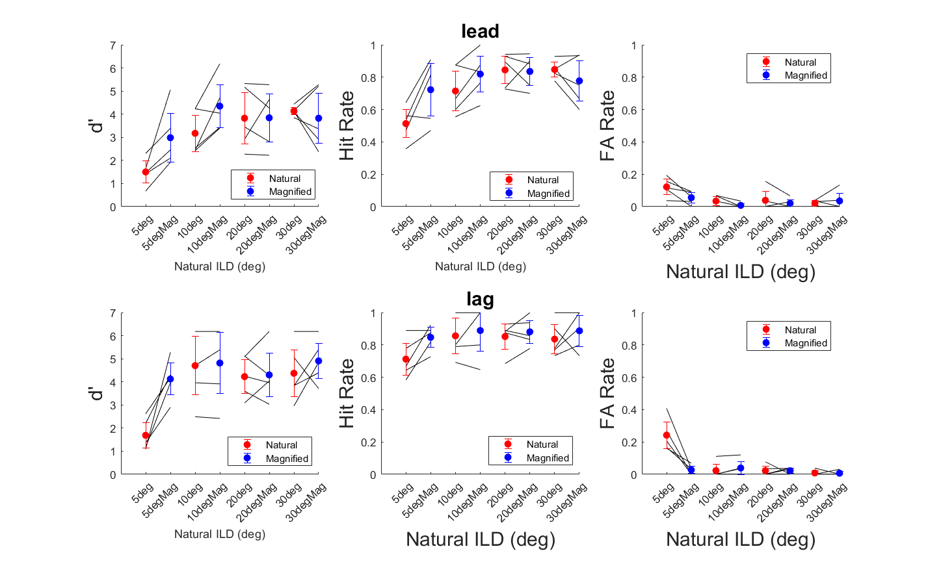

Slide 13
After this pilot….
We decided to cut 30 degrees from the pilot (by that point subjects are doing their best) and to zoom in on the others. Perhaps the task is too easy

Slide 14
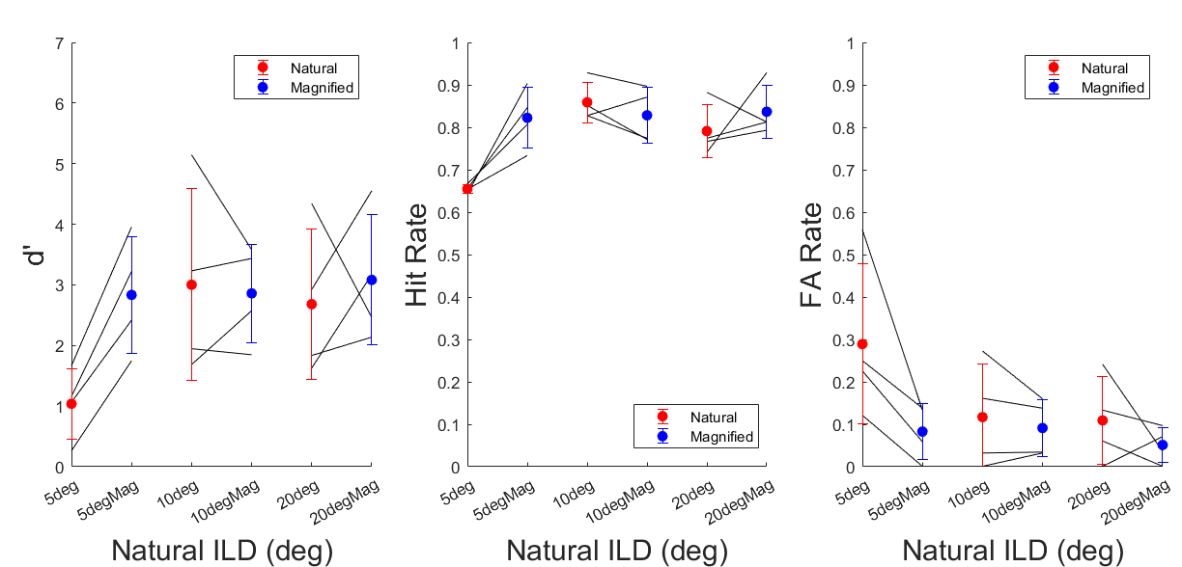
With 300 ms tokens, subjects also plateau beyond 5 degrees *sad trumpet noise*

Slide 15
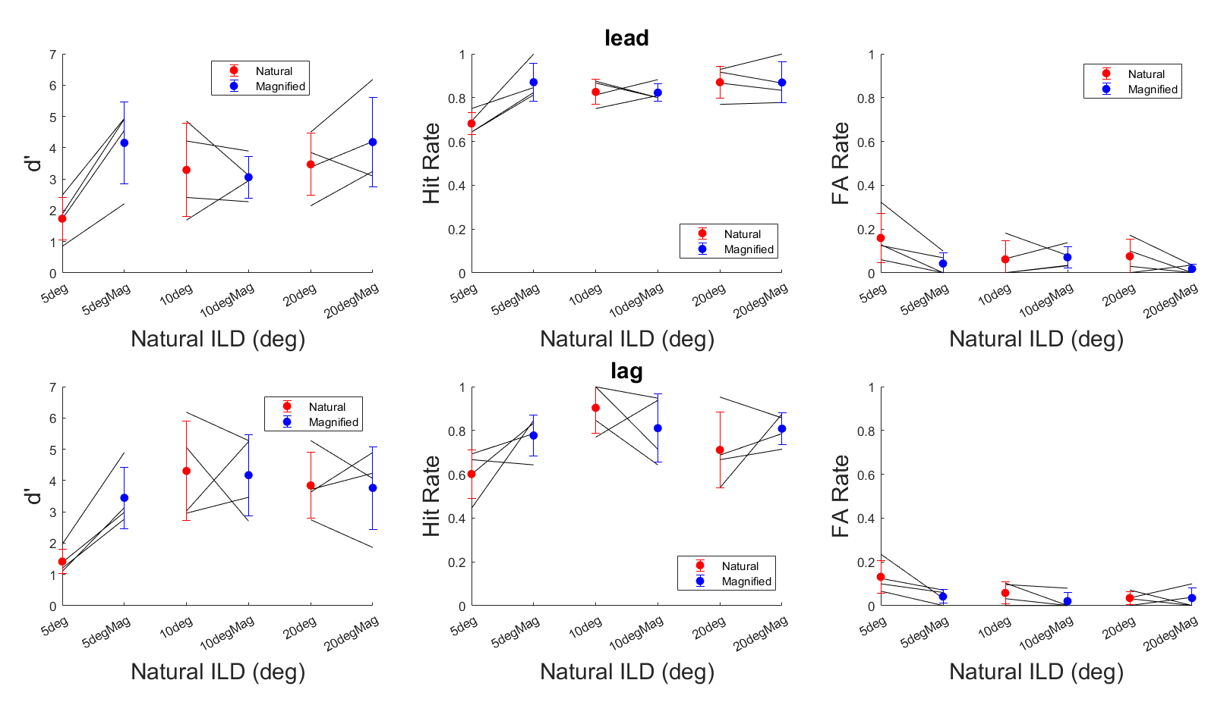

Slide 16
Question
The difference in FA rates with larger ILDs is much lower than in previous experiments…whats going on?!
Ben’s hypothesis: With “sh” sound every token, subjects rely on the high frequency information to segregate with ILDs
To test this hypothesis: (5 deg, 10 deg)*(Natural, Magnified)*(Broadband, Low Passed tokens)
4th order butterworth, cutoff = 1.2 kHz
Used filtfilt so phase info (i.e. ITDs) are better preserved

Slide 17
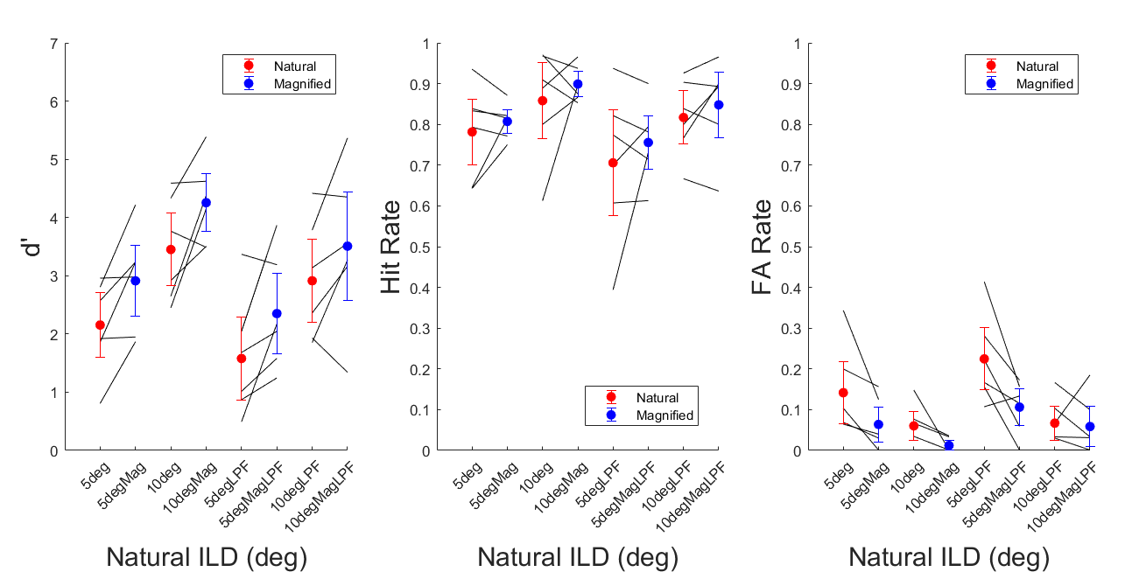
Subjects rely on high frequency “sh” information to perform the task with ILDs?
Also, here I see differences at 10???? Eat it 500 ms tokens!!!

Slide 18
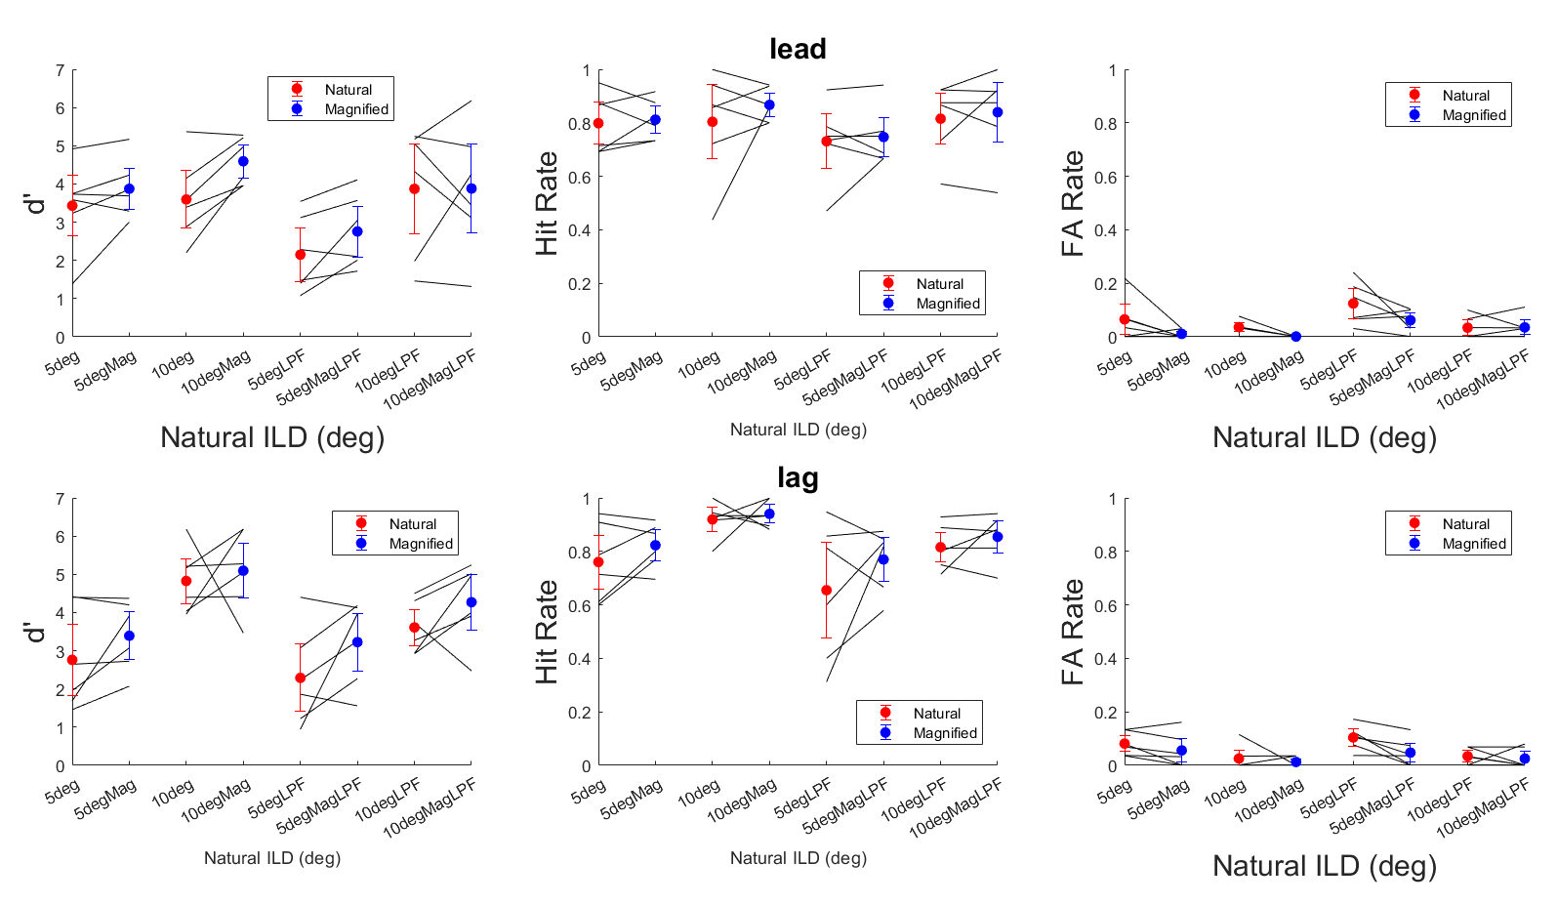

Slide 19
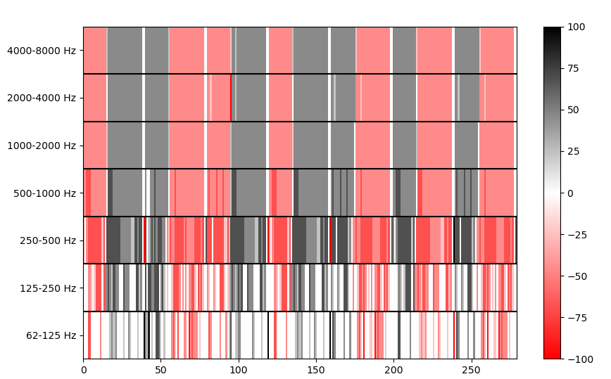
ITD Tracks (5 deg)

Slide 20
300 ms
?
50 ms
?
250 ms
9.6
?
16 token pairs * 600 ms/pair = 9.6 sec

